Slide 1
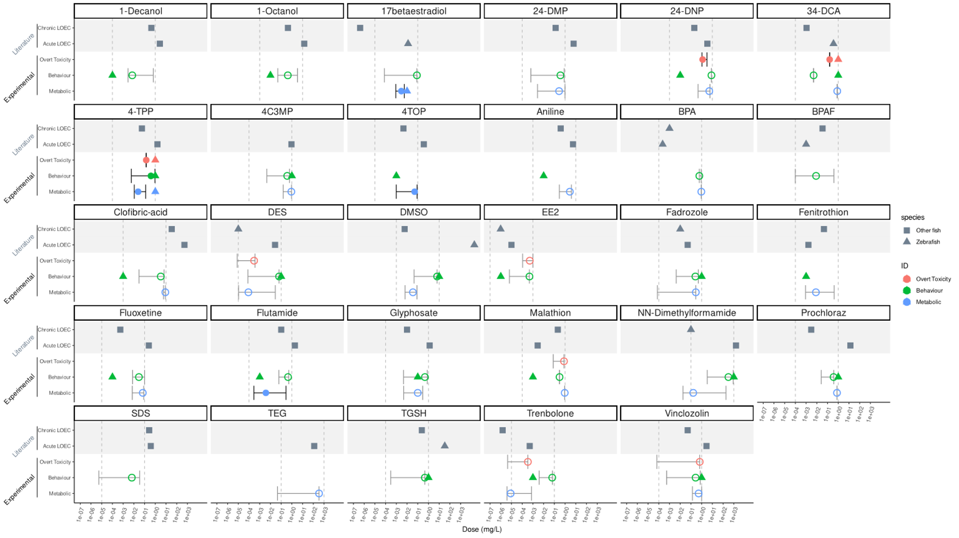
Activity
Species
BMD (not active)
Other fish
BMD (active)
Zebrafish
Endpoint
Zebrafish
Overt Toxicity (BMD)
Overt Toxicity (LOEC)
Behaviour (BMD)
Behaviour (LOEC)
Metabolic (BMD)
Metabolic (LOEC)

